Slide 1

Hadoop
(The Big Data PIG Out) by Jason Cohn Guggenheim Partners

Slide 2
Big Data (What is it?)
Still being defined. Buzzword to describe massive volume of both structured and unstructured data that is so large it is difficult to process using traditional database and software technologies.
Three V’s
Volume
Variety
Velocity
Examples – TB to PB of data all from different sources. Loosely structured. High Value, Diverse and new Data/Information Types. Raw

Slide 3
Big Data Types
Data could be grouped in the following categories:
Tabular data is structured as rows, with all rows having the same predefined list of columns. This corresponds to data that can be stored in a relational database table or exposed thru a HIVE table in Hadoop.
Unstructured data corresponds to all other cases:
Lines of text: The data can be divided into rows of text. The structure of each line can be managed by a Hadoop job.
Binary data: The whole data is a single binary object, such as an image (.png, .jpg) or a video. This could include compressed files.

Slide 4
You know you have Big Data when…
EMC Names a new product after you
Your query requires two DBA generations to see it return data
First item on your bucket list is “Finish Data Model”
You spend more time dealing with storage than data
Your existing platform breaks or becomes unmanageable

Slide 5
Trends Driving Big Data
Cost of managing data
Increased data generation
Poor management
Data storage
Cheaper storage.
Fear to delete
Rise of data value

Slide 6
Data Science
Big data is closely tied to the emergence of data science
Combines math, programming and science
Data Scientist have the following qualities:
Technical expertise – Deep expertise in some scientific discipline
Curiosity – Desire to go beneath the surface. Distill problems to hypotheses / prove.
Storytelling – Ability to use data to tell a story and communicate
Cleverness – Look at a problem in a different, creative way

Slide 7
Big Data Solutions Market
Segmented Market
Hardware – Storage, Servers, Networking
Big Data Distrobutions & Frameworks – Cloudera, IBM, Microsoft
Data Management – NOSQL DB’s, Data Integration, Data Quality/Governance
Analytics and Visualization – BI Tools, Analytical application. *Week area
Services – Consulting, Training, Hosting, Software – Cloudera and Amazon Web Services

Slide 8
Big Data Vendors
Hundreds of Big Data distributions and frameworks
Mostly open source
Cloudera, Vertica, Aster Data, Greenplum, etc
Hadoop Clear Front Runner in distributions

Slide 9
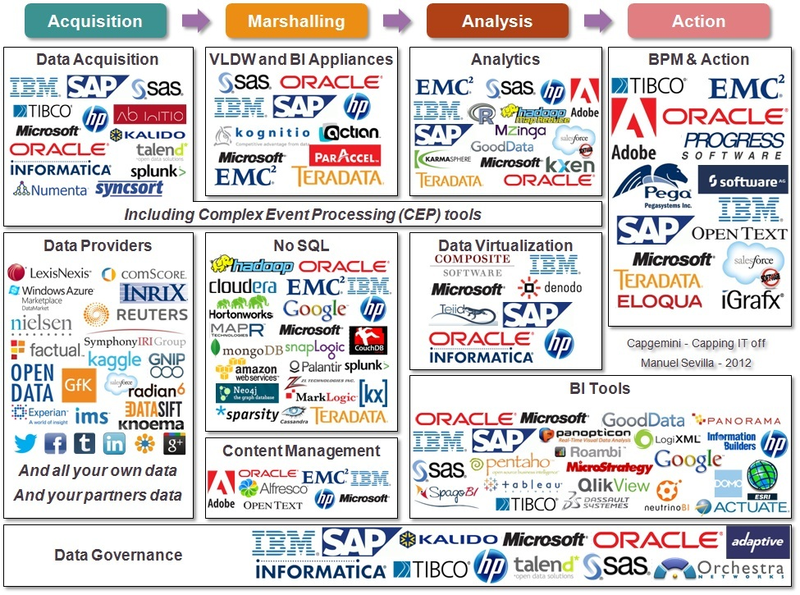
Big Data Vendor Space

Slide 10
Apache Hadoop Framework
The Apache™ Hadoop™ project develops an open source framework that enables distributed storage and computing on inexpensive hardware to handle large volumes of data. At the core of Hadoop, there are two main components:
Hadoop Distributed File System (HDFS™) stores and replicates blocks of data on the different computers that constitute a Hadoop cluster. The blocks are parts of files. This file system relies on the operating system (OS) file system. On Windows Server and Windows Azure, HDFS leverages NTFS on each and every node of the cluster.
Hadoop Map Reduce is the framework that implements the Map Reduce algorithm. This algorithm enables highly distributed computing in two main phases based on the usage of keys and values. The map phase transforms key/value input into other key/value outputs. After an intermediary shuffle step has sorted the data by their new keys, the Reduce phase can consolidate the values that were calculated in the first place by the map phase. Several map/reduce jobs can be chained if necessary.

Slide 11
Framework Components
HDFS is the distributed file system. Fault tolerant, designed for failure of hardware.
Map Reduce is the batch job framework. Fault tolerant algorithms. Created by Google 04.
PIG is a high level language that can describe jobs executions, and data flows. It also enables the execution of several jobs from one script. More procedural, created by Yahoo.
HIVE provides HiveQL, a SQL like language on top of Map Reduce. It is very popular because many people master SQL. Created by Facebook.
SQOOP enables data exchange between relational databases and Hadoop clusters. The name starts like SQL and ends like HADOOP. Connector for Hadoop and RDBMS.

Slide 12
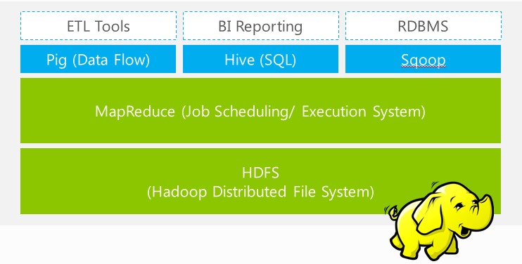
Framework Stack

Slide 13
HDFS
Distributed file/”storage” system. Designed to scale for large files/data.
Data broken down into blocks (64mb). Blocks are copied and then distributed across DataNodes cluster. Controlled by NameNode
If a DataNoder fails, the NameNode will find missing data residing elsewhere in the cluster, allowing processing to continue while the failed node is restarted or replaced.
Written in Java. Used in other apps being developed at Apache - HBase

Slide 14
Pig Vs. Hive
Pig is a platform for creating MapReduce programs with Hadoop
Flow of data taken in small steps
Hive is a DWH system built for Hadoop that allows easy data aggregation, ad-hoc queries and analysis of large data sets stored in Hadoop compatible file systems
SQL Like to interact with data, can call reduce mapper functions
Integrating with ODBC BI tools

Slide 15
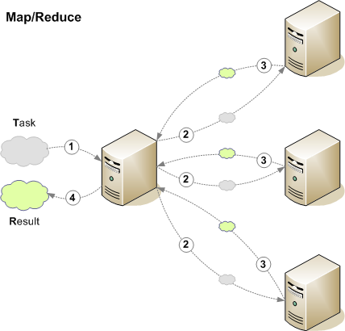
Hadoop Secret Sauce

Slide 16
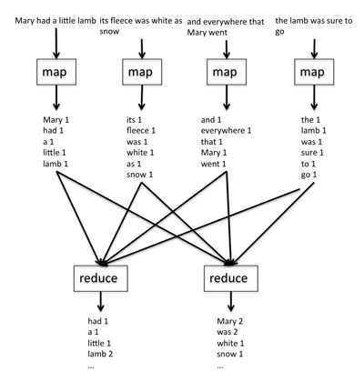
Map Reduce Concept

Slide 17
What Does Hadoop Offer
Master/ Slave nodes – Replication and scheduling is automatic
Handles node failure automatically
Linear Scalability
Low up front software / hardware costs
Ability to quickly analyze massive collections of data without modeling

Slide 18
What Does Hadoop Lack
Front end tools
Standards – Evolving architecture
HDFS cannot be mounted like a regular file system
No debugging interface – lines in log files
ZERO real time capabilities

Slide 19
RDBMS vs. Hadoop?
WRONG QUESTION
RDBMS and Hadoop are designed to meet different needs

Slide 20
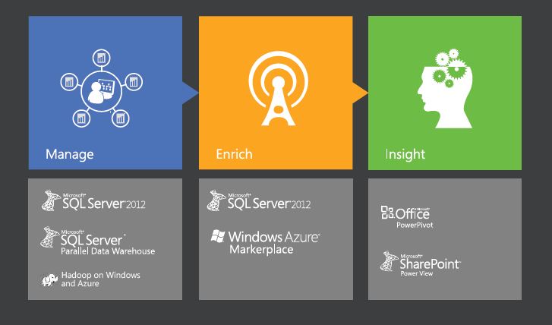
Microsoft Big Data Vision

Slide 21
Hadoop for Windows/Azure (HDInsight)
HDInsight is Microsoft’s 100% Apache compatible Hadoop distribution, supported by Microsoft
Available both on Windows Server or as a service on Windows Azure
Microsoft has partnered with Hortonworks on the distribution

Slide 22
HDInsight
Analyze Hadoop data with familiar tools – Excel 2013 w/ Hive ODBC driver
Insights from any data- SSAS, Hive, SQL Server 2012
Simplified programming- Integration with . NET (C#) using new JavaScript libraries. Javascript used to write map reduce programs and deploy in browser. Microsoft is getting this certified with Apache. *Streaming?

Slide 23

DEMO

